Slide 1

Efficient Multi-User Hybrid Precoding and Combining for mmWave Massive MIMO Systems
Kaijie Zeng, Yuanli Ma, Bin Yan, Zheng Wang*, Yili Xia
Southeast University, Nanjing, China
Presented by: Kaijie Zeng (kaijie_zeng@seu.edu.cn)
Paper ID : CT 4363
Notes:
Hello everyone, thanks for joining this presentation.
My name is Kaijie Zeng and I’ m a first-year master student at Southeast University.
Today, It’s my honor to present our paper“Efficient Muiti-User Hybrid Precoding and Combining for Millimeter-Wave Massive MIMO Systems”.

Slide 2


Part 01
Background and Motivation
Part 02
System Model
Part 03
Hybrid Precoding and Combining Design
CONTENTS
Part 04
Complexity and Feedback Overhead
Part 05
Simulation Results
Part 06
Conclusions
Notes:
This presentation consists of the following 6 parts.

Slide 3
I -
Background and Motivation
5G and beyond needs to support the soaring demand for higher data-rate in various new services and applications.
Shannon’s capacity formula:
Capacity [bps] = Bandwidth [Hz] × Sum-Rate [bps/Hz]
Thus, the capacity can be maximized through:
Higher frequency band mmWave, ...
Efficient utilization of spatial resources Massive MIMO, ...
Advanced transmission techniques Precoding, ...
Reciprocal
Integration
Hybrid Precoding Structure for Massive MIMO
Role: An alternative to the fully digital precoding structure
Objective: Maximizing the downlink sum-rate
Prohibitive hardware cost & power consumption from per-antenna radio frequency (RF) chains
Notes:
1. 新应用的出现需要高数据率：Nowadays, as the emergence of new applications such as AR/VR, ISAC, etc, 5G and beyond needs to support the soaring demand for higher data throughput.
2. 高数据率的公式，以及获得方式：According to Shannon’s capacity formula, this requirement can be met by exploring higher frequency bands, such as the millimeter-wave band; efficient utilization of spatial resources, such as massive MIMO; and employing advanced transmission techniques, such as precoding.
3. 预编码在毫米波和大规模 MIMO 中发挥作用；Precoding plays an important role in the reciprocal integration of millimeter-wave and massive MIMO to effectively compensate for severe path loss and enables high sum-rate.
4. 全数字预编码的问题：However, fully digital precoding structure is impractical due to its prohibitive hardware cost and power consumption from per-antenna radio frequency (RF) chains.
5. 混合预编码的引入：To tackle this problem, hybrid precoding structure has emerged as an alternative, which connects a digital precoder with an analog one with far fewer RF chains to maximize the downlink sum-rate.

Slide 4
I -
Background and Motivation
Research gap in multi-user (MU) hybrid precoding and combibing:
High Sum-rate Performance vs Low Feedback Overhead!
Existing algorithms with high sum-rate are achieved via alternating optimization, incurring high feedback overhead
Existing algorithms with low feedback overhead provide insufficient sum-rate
From a practical perspective, this paper proposes a scheme called EMU-HPC
that attains superior performance with minimal feedback overhead!
Notes:
1. 多用户(MU)混合预编码中的冲突，具体是什么？：However, in multi-user MIMO, or MU-MIMO hybrid precoding and combining, we identified a conflict between sum-rate maximization and low feedback overhead.
2. 特别地，高合速率的算法依赖交替优化，导致高反馈开销：Specifically, existing algorithms with high sum-rates tend to rely on alternating optimization, which results in high feedback overhead.
3. 相反，低反馈开销的算法倾向于提供不足的合速率：In contrast, algorithms with low feedback overhead tend to provide insufficient sum-rate.
4. 这就是一个研究差距：This is a clear research gap.
5. 受此启发，我们提出既有高数据率，又有低反馈开销的 EMU-HPC：Inspired by this, we propose a hybrid precoding and combining scheme called EMU-HPC that attains superior performance with minimal feedback overhead.

Slide 5
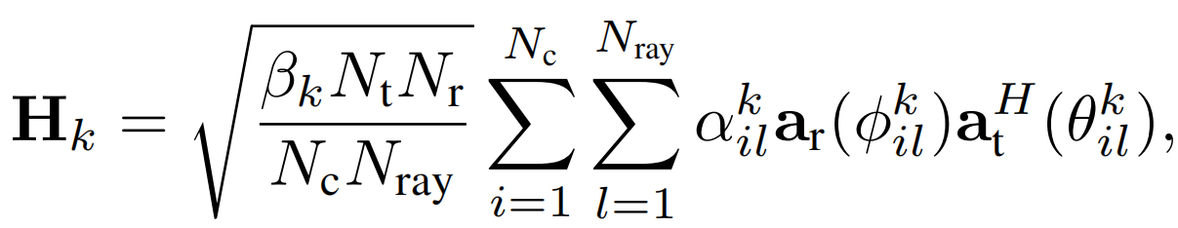
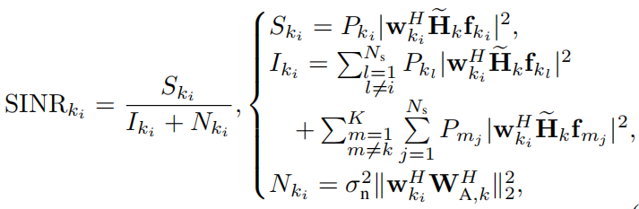
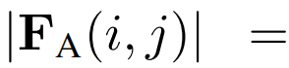
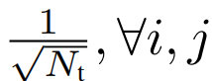
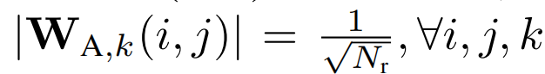
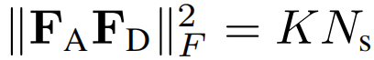

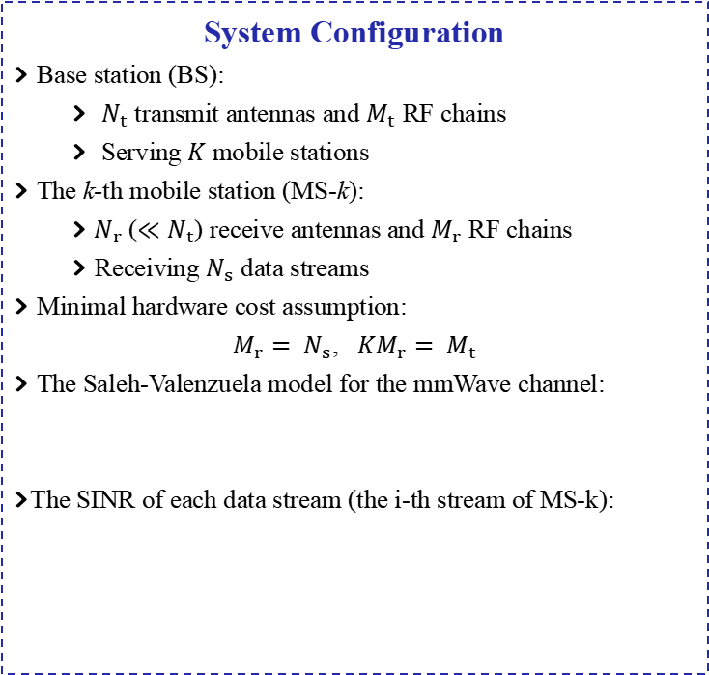
II-
System Model
System Configuration
Base station (BS):
$N_{t}$ transmit antennas and $M_{t}$ RF chains
Serving $K$ mobile stations
The k-th mobile station (MS-k):
$N_{r}$ ($≪N_{t}$) receive antennas and $M_{r}$ RF chains
Receiving $N_{s}$ data streams
Minimal hardware cost assumption:
$M_{r}= N_{s}$, ${KM}_{r}= M_{t}$
The Saleh-Valenzuela model for the mmWave channel:
The SINR of each data stream (the i-th stream of MS-k):
A single-cell MU-MIMO downlink system
Constraints
Constant modulus (CM) constraints:
Total transmit power constraint:
Notes:
1. 系统模型：For system model, we cosider a single-cell MU-MIMO downlink system.
2. 数量关系：The base station (or BS) equipped with Nt transmit antennas and Mt RF chains serves K mobile station, or MS and each MS has Nr receive antennas and Mr RF chains to multiplex Ns data streams. To minimize the hardware cost, we assume to use the least number of RF chains at both the BS and all MS.
3. 信道建模与信号处理流程：The millimeter-wave channel is modeled by the Saleh-Valenzuela model. At the BS, the data streams is processed by a digital precoder and an analog precoder before transmission, and at each MS, the received signal is processed by an analog combiner and a digital combiner.
4. SINR：From the SINR of each received data stream, it is evident that desired signal power degrades due to the existence of multi-user interference, intra-user interference, and the noise.
5. 约束：模拟域恒模约束、发送总功率约束：Additionally, since analog precoders and combiners are implemented by phase shifters, their entries are subject to constant modulus constraints.
Plus, a total transmit power constraint is imposed on the hybrid precoders.

Slide 6
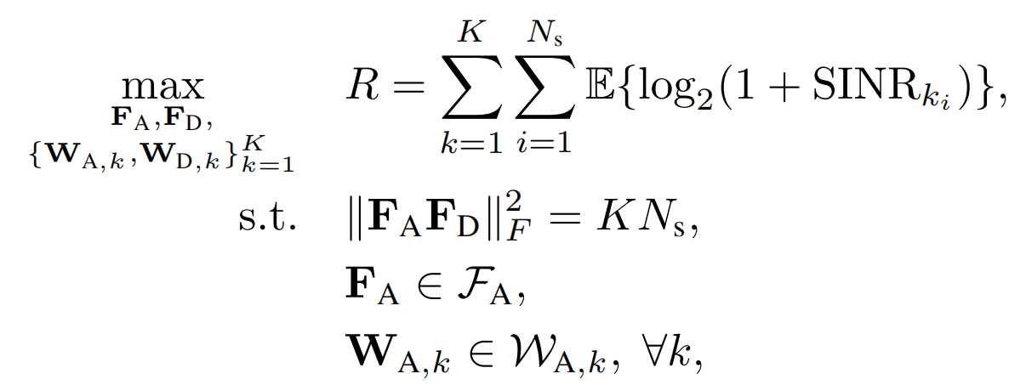
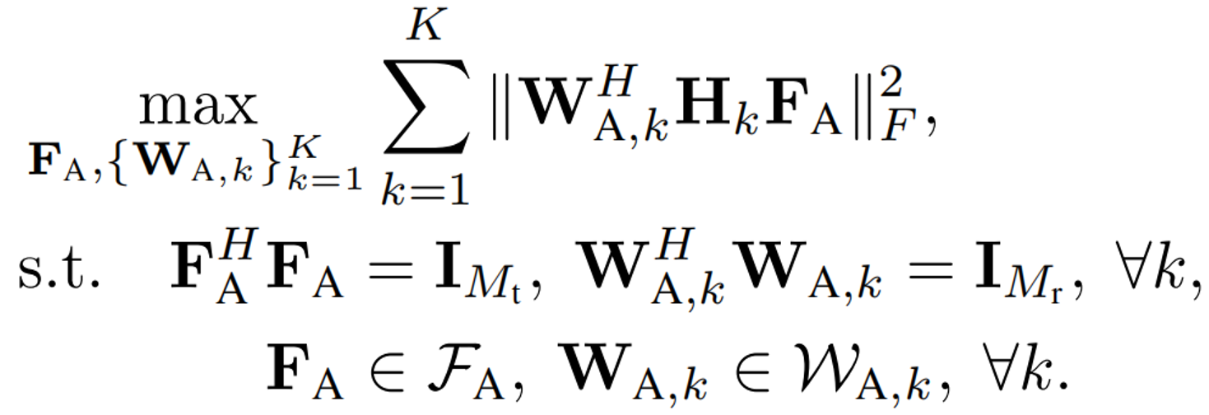
II-
System Model
The sum-rate maximization problem:
Solving it directly is almost impossible!
The non-convex CM constraints makes the global optimum intractable
As a result, existing research normally adopts the two-stage design pattern:
Analog stage: Maximizing array gains
Digital stage: Managing interference (and noise)
Specifically, the analog precoder and combiner can be obtained as:
This is conventionally solved via generalized low-rank approximations of matrices (GLRAM)^{[1]}
[1] J. Ye, “Generalized low rank approximations of matrices,” Machine Learning, vol. 61, no. 1-3, pp. 167–191, 2005.
Notes:
1. 高斯符号时，设计混合预编码的问题建模：Assuming Gaussian data symbols, the design problem of hybrid precoding and combining to maximize the sum-rate is formulated.
2. 但是，直接优化不可能，因为存在非凸的恒模约束：However, direct optimization it is almost impossible since the non-convex constant modulus constraints makes the global optimum intractable.
3. 避免直接设计，采取二阶段设计模式：As a result, existing methods adopt the two-stage design pattern:
4. 第一，实现模拟域设计，最大化阵列增益：Firstly, the analog stage design is performed to maximize the array gains and derive the analog precoder and combiners.
5. 基于模拟，数字域设计用于管理干扰和噪声：Then, based on this, the digital stage design is conducted to manage the interference and noise.
6. 特别地，我们模拟域的矩阵近似，传统求解方式：Specifically, the analog stage design can be obtained by matrix approximation, which is conventionally solved by the Generalized Low-Rank Approximations of Matrices, or GLRAM, framework.

Slide 7
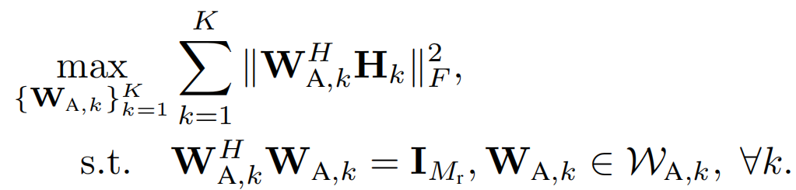
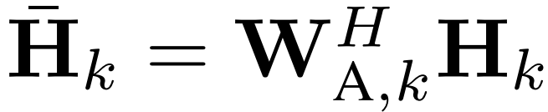
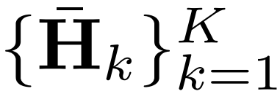
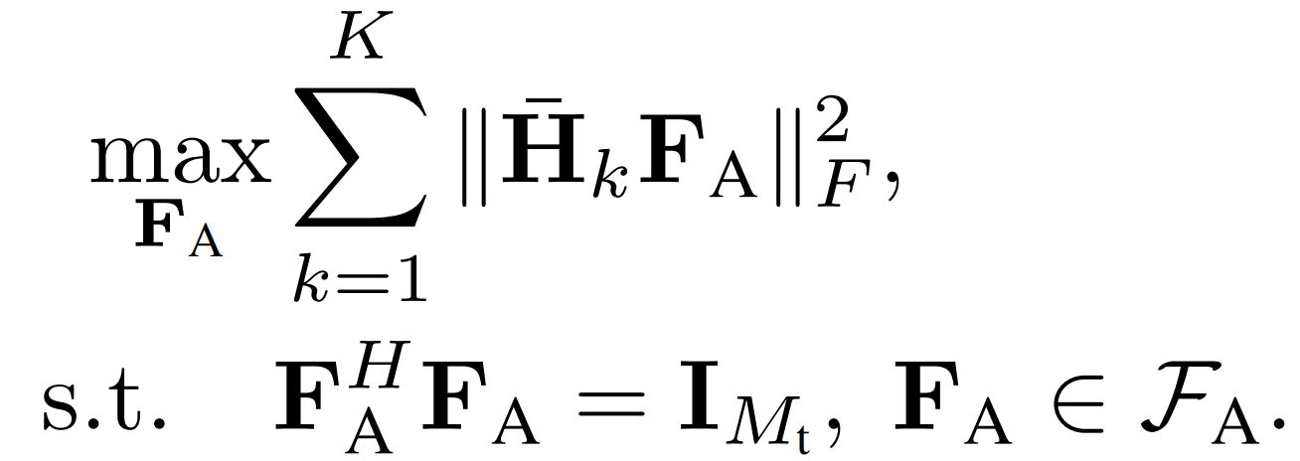
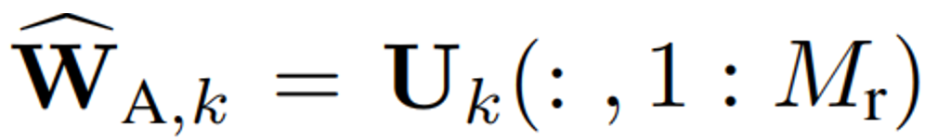
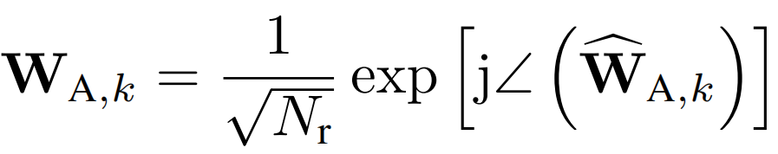
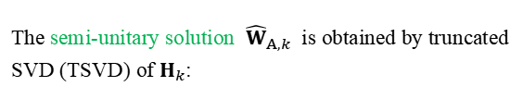
III-
Hybrid Precoding and Combining Design
Challenge 1: Alternating optimization in GLRAM $→$ Prohibitive feedback overhead
How to reduce the feedback overhead?
NI-GLRAM for Analog Combining
NI-GLRAM for Analog Precoding
The array gain maximization problem at MS-k:
Each MS feeds back channels to the BS without alternation:
The array gain maximization problem at the BS, based on the fed-back channels :
The semi-unitary solution ${\hat{W}}_{A,k}$ is obtained by truncated SVD (TSVD) of $H_{k}$:
Non-Iterative
GLRAM
Framwork
in Analog Stage
Each MS computes the TSVD via the VR-PCA^{[2]} method within the LazySVD^{[3]} framework for lower complexity.
Without alternation, can this design effectively maximize the array gain?
No! It fails to distinguish between array gain and multi-user interference (MUI), but maximizes both!
Phase extraction:
This leads to performance degradation!
[2] O. Shamir, “A stochastic PCA and SVD algorithm with an exponential convergence rate,” in Proc. 32nd Int. Conf. Mach. Learn., 2015, pp.144–152.
[3] Z. Allen-Zhu and Y. Li, “LazySVD: Even faster SVD decomposition yet without agonizing pain,” in Proc. 30th Int. Conf. on Neural Inf. Process. Syst., 2016, pp. 982–990.
Notes:
1. 第一重挑战，传统 GLRAM 中的交替优化导致高反馈开销，进而导致通信时延并阻碍实际部署：Here arises the first challenge, the alternating optimization involved in the conventional GLRAM framework leads to prohibitive feedback overhead, which may cause extra communication delays and hinder practical deployment.
2. 看左侧：为了解决我们提出使用 NI-GLRAM：To reduce the feedback in the analog stage, we employ a Non-Iterative GLRAM, or NI-GLRAM, framework.
--- 具体用 NI-GLRAM 做模拟合并 ---
2-1. 具体地，每个用户的模拟合并被解耦为一个阵列增益问题：Specifically, at each MS, the analog combining design is decoupled as an array-gain maximization problem that solely depends on the physical channel.
2-2. 除去恒模约束，其对应的半酉解由 TSVD 获得：Without constant modulus, The corresponding semi-unitary solution is obtained through a truncated singular value decomposition, or TSVD of the channel.
2-3. 进一步降低计算负担：To further reduce the computational load at the MS, the TSVD is efficiently computed using the Variance-Reduced Principal Component Analysis, or VR-PCA, method within the LazySVD framework.
2-4. 最后，相位提取：Finally, The analog combiner is derived by phase-extracting the resulting semi-unitary matrix due to the constant modulus constraint.
--- NI-GLRAM 做模拟预编码 ---
3-1 反馈中间信道，基于中间信道和 NI-GLRAM 得到了模拟预编码问题：After analog combining, each MS is required to feed back only an intermediate channel H k,bar to the BS. Based on all fed-back channel and the NI-GLRAM framework, the array-gain maximization problem for analog precoding is then given.
--- 模拟预编码的疑问---
3-2. 但是，不带任何交替的话，这个真的能最大化阵列增益吗？But, here is another question, without alternation, can this design really effectivelly maximize the array gain?
----------(click)
3-3. 不，因为目标函数没有区分增益与多用户干扰：The answer is No! This is because the objective function fails to distinguish between the array gain and multi-user interference, or MUI, but maximizes both.
--------- (click)
3-4. 这导致了性能损失：This leads to performance degradation.

Slide 8
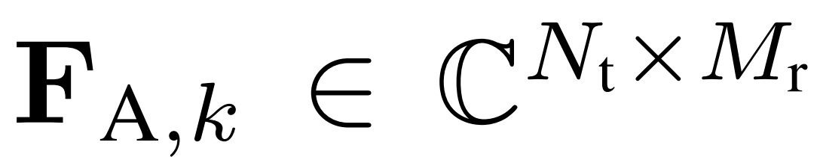
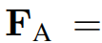
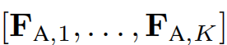
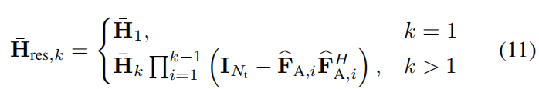
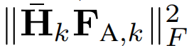
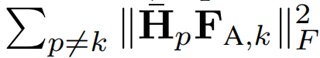
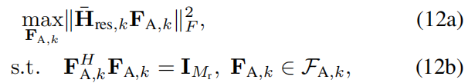
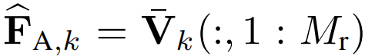
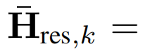
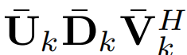
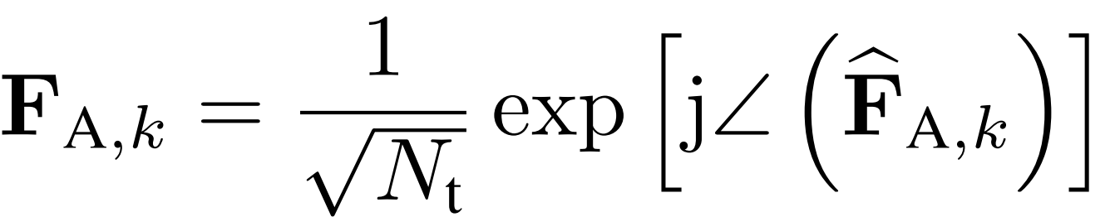
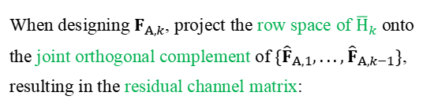
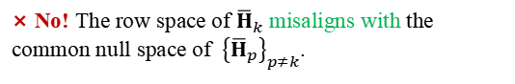
III-
Hybrid Precoding and Combining Design
Challenge 2: Low feedback overhead $→$ Insufficient sum-rate performance
NI-GLRAM for Analog Precoding
MUI Suppression Scheme
How to enhance
the sum-rate without
alternation?
When designing $F_{A,k}$, project the row space of ${\overline{H}}_{k}$ onto the joint orthogonal complement of $\{{\hat{F}}_{A,1},...,{\hat{F}}_{A,k−1}\}$, resulting in the residual channel matrix:
We propose to design dedicated analog precoder for each MS:
For each MS, this distinguishes the array gain it harvests, and the MUI it causes:
vs.
Then, a MUI-aware array gain maximization problem is given as
Managing
Interference
in Analog
Precoding
Can we design each analog precoder jointly maximize the array gain and cancel all the generated MUI?
× No! The row space of ${\overline{H}}_{k}$ misaligns with the common null space of ${\left\{{\overline{H}}_{p}\right\}}_{p≠k}$.
The semi-unitary solution is obtained via TSVD:
√ However, partially suppressing the MUI and performing MUI-aware array harvesting is viable!
Phase extraction:
Notes:
1. 因此，这产生了另一个问题：Therefore, there arises another challenge: the algorithms with low feedback overhead often suffer from insufficient sum-rate performance.
2. 看左侧，为了提高合速率并且不交替，我们在模拟预编码中引入干扰管理：To enhance the sum-rate without alternation, we propose to manage interference in analog precoding.
--- 第一件事：专用预编码器 ---
3-1. 专用预编码器：At first, we design dedicated analog precoders for each MS.
3-2. 对于每个MS，专用预编码器的作用：Specifically for each MS, this distinguishes the desired array gain it harvests—illustrated on the left side—from the MUI it causes to other MSs—shown on the right side.
------ (click)
3-3. 那么，能否设计模拟预编码器使得阵列增益最大化，并且消除所有干扰吗？
So, Can we design each analog precoder to jointly maximize the array gain and cancel all the generated MUI?
------(click)
3-4. 答案是否定的，因为对于 MS-k 不对齐性：The answer may be No！This is because for any MS-k, the row space of fed-back channel H bar,k misaligns with the common null space the other fed-back channels.
3-5 那么，我们能怎么做呢？Well, so what can we do?
------(click)
3-6 自然的想法：A natural idea is to partially suppress the MUI.
3-7 幸运的是，这可以被做到：Luckily, it works! Indeed, partially suppressing the MUI and performing MUI-aware array gain harvesting is viable, shown as follows.
------(click)
--- 第二件事：开始我们的设计 ---
4-1. 递归设计及其解释：We propose a recursive design, which means that when designing the analog precoder for the the k-th MS, or MS-k, all previous ones have been determined.
4-2. 正交投影，产生残余信道矩阵：We first project the row space of H bar,k onto the joint orthogonal complement of previously designed semi-unitary analog precoders, resulting in the residual channel matrix.
4-3. MUI-aware 阵列增益最大化问题，求解方式：Then, an MUI-aware array gain maximization problem is given, and its semi-unitary solution is obtained via TSVD of the residual channel matrix.
4-4 相位提取：Finally, the resulting semi-unitary matrix is phase-extracted to yield the analog precoder for MS-k.

Slide 9
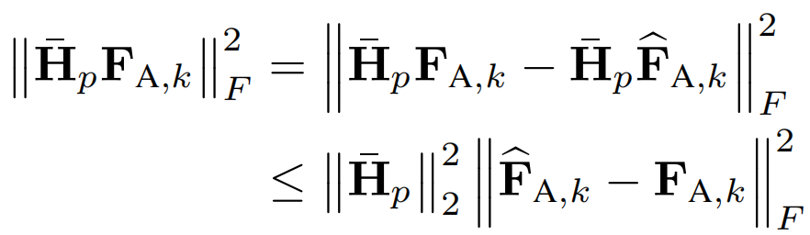




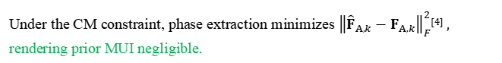
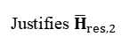
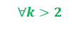
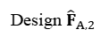
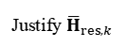

III-
Hybrid Precoding and Combining Design
MUI Suppression Property
MUI Suppression Property
(1) The validity of computing ${\overline{H}}_{res,k}$:
(2) The MUI suppression efficacy of MS-k:
Property: The derived analog precoder effectively suppresses the MUI it causes to prior MSs when harvesting the array gain.
The recursive design guarantees mutually orthogonal previous analog precoders for all MSs.
Proof
Justifies ${\overline{H}}_{res,2}$
The MUI generated by MS-k to prior MSs is upper-bounded as:
Given ${\hat{F}}_{A,1}$ is semi-unitary
${\hat{F}}_{A.2}^{H}{\hat{F}}_{A.1}^{ }=0_{M_{r}×M_{r}}$
Design ${\hat{F}}_{A,2}$
An all-zero matrix due to the orthogonality
$$∀k>2$$
If $\{{\hat{F}}_{A,1},...,{\hat{F}}_{A,k−1}\}$ are mutually orthogonal
Under the CM constraint, phase extraction minimizes ${\left\|{{\hat{F}}_{A,k}−F}_{A,k}\right\|}_{F}^{2}$^{[4]} , rendering prior MUI negligible.
Design ${\hat{F}}_{A,k}$
Justify ${\overline{H}}_{res,k}$
The derived ${\hat{F}}_{A,k}$ is orthogonal to $\{{\hat{F}}_{A,1},...,{\hat{F}}_{A,k−1}\}$
However, the MUI caused to later MSs still persists.
Achieving a balance between array gains and MUI suppression!
[4] X. Wu, D. Liu, and F. Yin, “Hybrid beamforming for multi-user massive MIMO systems,” IEEE Trans. Commun., vol. 66, no. 9, pp. 3879–3891, Sep. 2018.
Notes:
1. 问题引导：Here you might ask, well, what is the MUI suppression properties of such an analog precoding scheme?
we have the following two properties:
2. 解释计算残余信道矩阵的合法性：The first property is that, we explain the validity of computing the residual channel matrix:
2-1. 递归设计确保了合法性：The recursive design guarantees mutual orthogonality among all previously derived semi-unitary analog precoders for each MS, validating the computation of each subsequent residual channel matrix.
2-2. 流图：As shown in the flow chart, the reason is that:
2-3. 归纳法中的规律：By induction, if all previously designed semi-unitary analog precoders are mutually orthogonal, the next derived one will also remain orthogonal to all previous ones.
2-4. 成立的原因：Such a condition naturally holds, since the first one is semi-unitary, and the second precoder is made to be orthogonal to the first one.
3. 第二部分：The second property is that:
3-1. 性质一：The derived analog precoder effectively suppresses the MUI it causes to prior MSs when harvesting the array gain.
3-2. 性质的证明：Due to the mutual orthogonality among the previous semi-unitary analog precoders, minimizing the upper bound of each prior MUI term is equivalent to minimizing the distance between the ideal semi-unitary analog precoder and the real analog precoder, which is achieved through phase-extraction used in our scheme. This reduces the MUI to all prior MSs to a negligible level.
3-3. 但是，剩余的干扰还在：However, the MUI caused to later MSs still persists due to the balance with array gain harvesting.

Slide 10
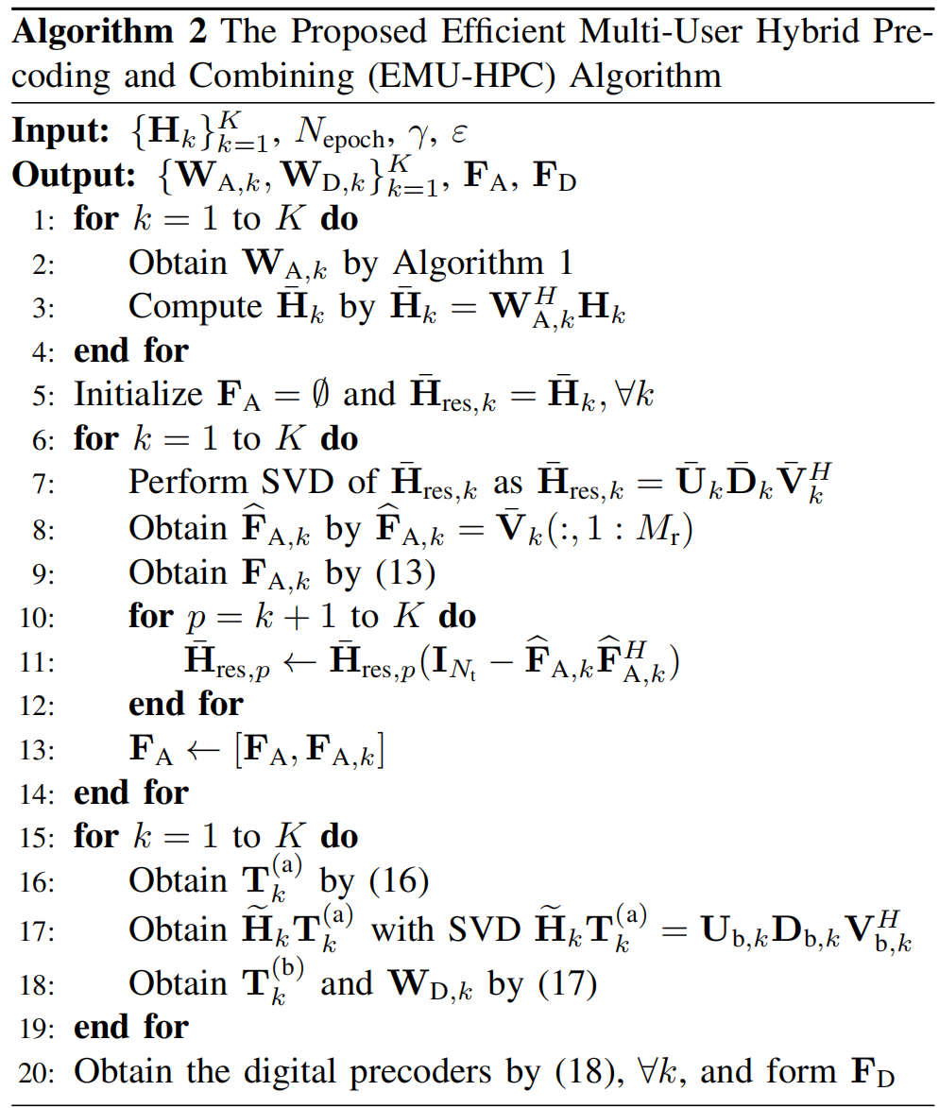
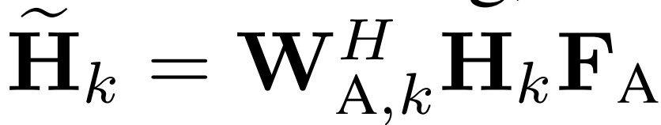
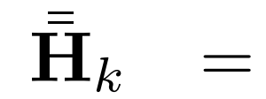
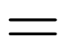
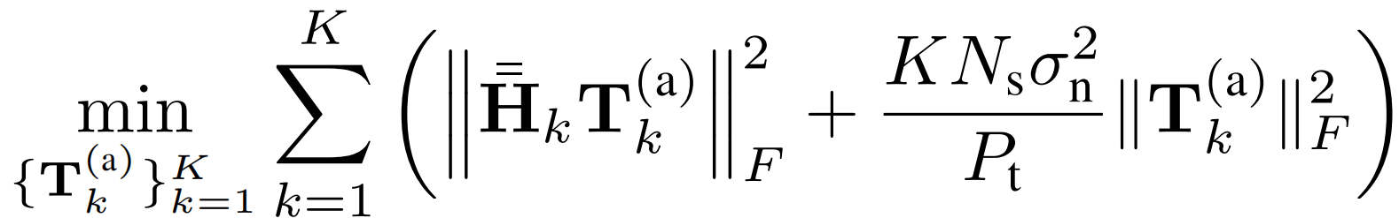
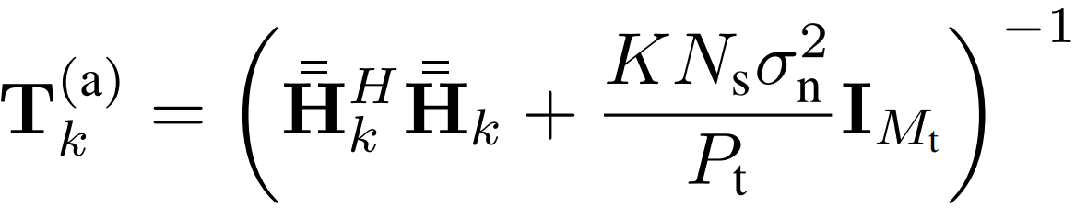
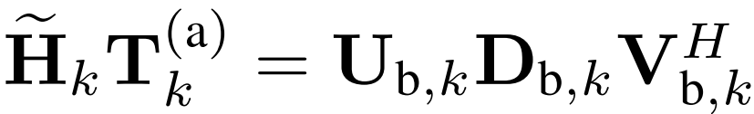
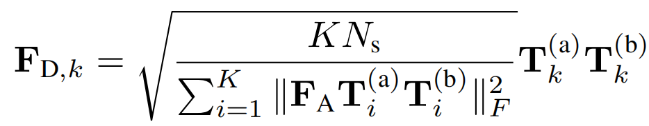
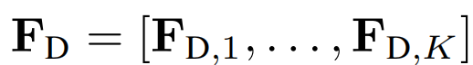
III-
Hybrid Precoding and Combining Design
The RCD Digital Design
The EMU-HPC Algorithm
The equivalent baseband channel:
How to deal with the remaining interference?
Using the RCD^{[5]} method, suppressing the remaining MUI and noise under MMSE criterion:
with the following solution:
Joint Analog-Digital Interference
Suppression
Next, the intra-user interference is eliminated in each subchannels:
The overall digital precoder with nomalized power:
[5] F. Khalid and J. Speidel, “Robust hybrid precoding for multiuser MIMO wireless communication systems,” IEEE Trans. Wireless Commun., vol. 13, no. 6, pp. 3353–3363, Jun. 2014.
Notes:
1. 数字域消除剩余的干扰，基于模拟域建立的等效系带信道：The remaining interference and noise is managed in the digital stage by using regularized channel diagonalization, or RCD method, based on the equivalent baseband channel established by the analog design.
2. 数字域由 MMSE 准则设计，消除剩余的 MUI：In this stage, the digital precoder is first designed under the minimum mean-square error criterion, which effectively suppresses the residual MUI and noise to negligible levels.
3. 这使得MS可以在各自的子信道中优化传输：This enables each MS to optimize its transmission within its effective subchannel,
4. 其中，用户内干扰被子信道的最优数字预编码器和数字合并器消除：where the intra-user interference is further eliminated through the optimal digital precoder of the subchannel and the digital combiner
5. 最后，数字预编码器被归一化：Finally, the overall digital precoder is normalized to satisfy the total transmit power constraint.
6. 总结：In summary, the proposed Efficient Muiti-User Hybrid Precoding and Combining, or EMU-HPC method is shown in Algorithm 2 on the right side.

Slide 11
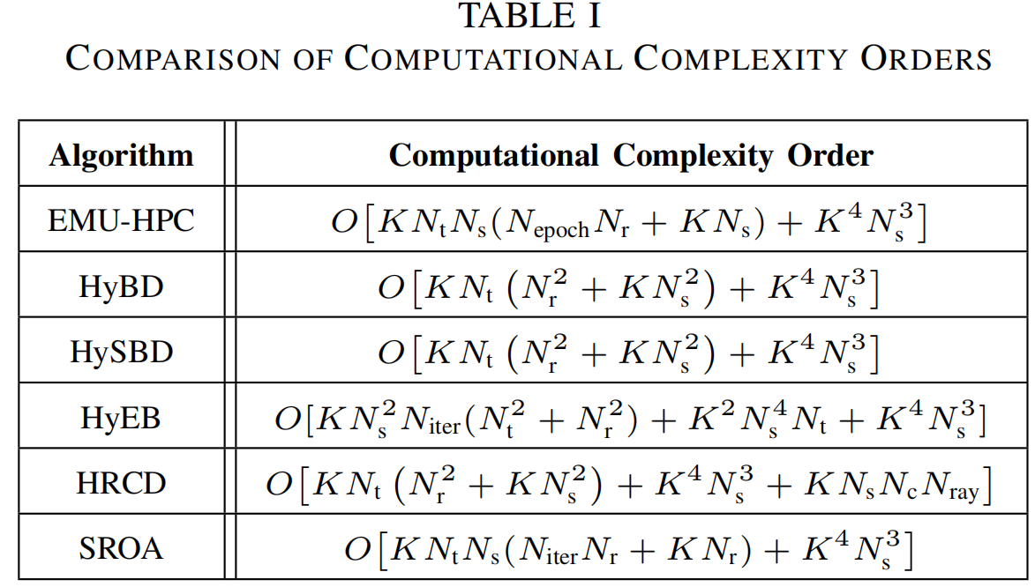
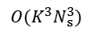
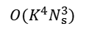
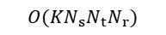

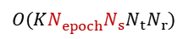
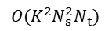

IV-
Complexity and Feedback Overhead
Complexity Analysis
Analog Stage Design
Digital Stage Design
Analog Combining
Computing the solutions to
the MMSE problem
$$O(KN_{epoch}^{ }N_{s}N_{t}N_{r})$$
Computing ${\{{\overline{H}}_{k}\}}_{k=1}^{K}$
$$O(K^{4}N_{s}^{3})$$
$$O(KN_{s}N_{t}N_{r})$$
Analog precoding
Computing the subchannels and
the related SVDs:
$$O(K^{2}N_{s}^{2}N_{t})$$
Computing the baseband channels
$$O(K^{3}N_{s}^{3})$$
The EMU-HPC method is computationally efficient!
$$O(K^{2}N_{s}^{2}N_{t})$$
Feedback Overhead Analysis
Note: The feedback overhead is quantified in terms of the number of fed-back matrix elements.
Algorithm | Analog Stage | Digital Stage | Lower?
EMU-HPC | $O(KN_{s}N_{t})$ (minimal level) | Same as all other algorithms | √
SROA | $O(KN_{s}N_{iter}{(N}_{r}+N_{t})$ (${\overline{N}}_{iter}$=14) |  | ×
Reduced feedback
overhead!
Notes:
In this section, we analyze the computational complexity and feedback overhead.
For the complexity analysis, the figure shows that the complexity of the EMU-HPC algorithm is significantly lower than existing ones, as verified by simulations.
This improvement arises because because the EMU-HPC algorithm reduces the complexity order in the analog stage from the quadretic of N_r to the product N_{epoch}N_{s}N_{r}, where N_{epoch} is the maximum number of epochs in VR-PCA. This demonstrates the proposed EMU-HPC is computationally efficient.
For feedback overhead analysis, we note that feedback overhead is quantified in terms of the number of fed-back matrix elements. Without allternation, the feedback overhead of EMU-HPC is at the minimal level, significantly lower than that required by SROA, which requires alternating optimization.

Slide 12




V-
Simulation Results
Sum-rate Performance
Multiplexing Performance
Complexity
EMU-HPC > other hybrid schemes
EMU-HPC > other hybrid schemes
EMU-HPC has the lowest complexity
Mainly due to the joint analog-digital interference suppression scheme
Due to balancing array gains and MUI suppression in analog precoding
Achieved by VR-PCA in LazySVD
Only $N_{epoch}^{ }=2$ is sufficient to outperform both HySBD and SROA
Notes:
In simulations, we evaluate the proposed EMU-HPC algorithm in the following three aspects.
For sum-rate performance, EMU-HPC outperforms other hybrid schemes, except at very low SNR. This improvement is mainly achieved through joint analog-digital interference suppression scheme
For multiplexing performance, EMU-HPC achieves higher sum-rate than other hybrid schemes at medium and high K, where K is the number of MS, and remains competitive at low K, which is mainly attributed to the balance between array gains and MUI suppression in analog precoding.
For computational complexity, EMU-HPC has the lowest complexity, only 2 eopchs in each VR-PCA are sufficient to outperform both HySBD and SROA.

Slide 13
VI-
Conclusion
We propose the EMU-HPC method for mmWave massive MU-MIMO to improve the sum-rate with low feedback overhead.
Minimal feedback overhead!
Lowest complexity
& better performance!
Analog Combining: VR-PCA
Analog Stage: NI-GLRAM
Analog Precoding: MUI-aware array gain
harvesting
EMU-HPC
Joint interference suppression
Digital Stage: RCD
Notes:
In this paper, we propose the EMU-HPC method for mmWave massive MU-MIMO to improve the sum-rate with low feedback overhead. NI-GLRAM is employed in the analog stage to maximize the array gain with minimal feedback. VR-PCA is employed in analog combining for low complexity, while joint analog–digital interference suppression is performed for higher sum-rate performance. Numerical results demonstrate that EMU-HPC achieves better sum-rate performance compared with existing hybrid precoding and combining algorithms.

Slide 14

THANK YOU
Kaijie Zeng, Yuanli Ma, Bin Yan, Zheng Wang*, Yili Xia
Southeast University, Nanjing, China
October 17th, 2025
Notes:
That’s all for my presentation. Thank you for your kind attention.

